Slide 1

Azure Functions Elevated
Sean Feldman

Slide 2

Agenda
Raw Azure Functions
AzFunc with NSB
Samples
Moving forward

Slide 3

Serverless
Notes:
Serverless is a great way to build backend parts of the system, focusing on the project objectives and not the infrastructure.

Slide 4
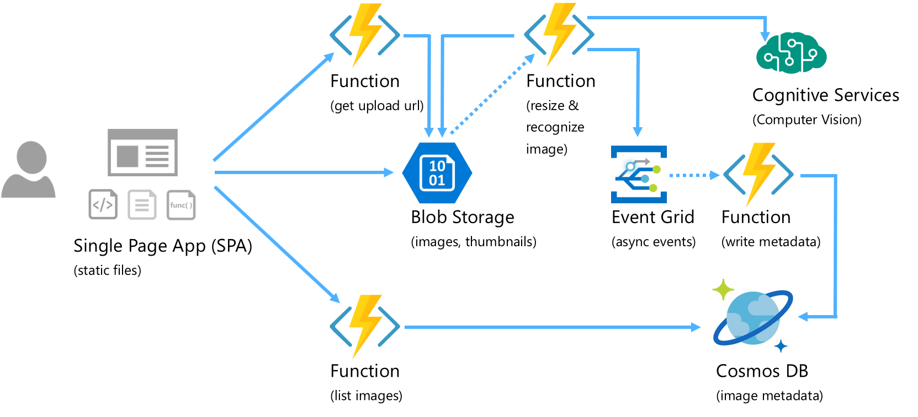
Notes:
Azure Functions are a great development model for event driven world.

Slide 5
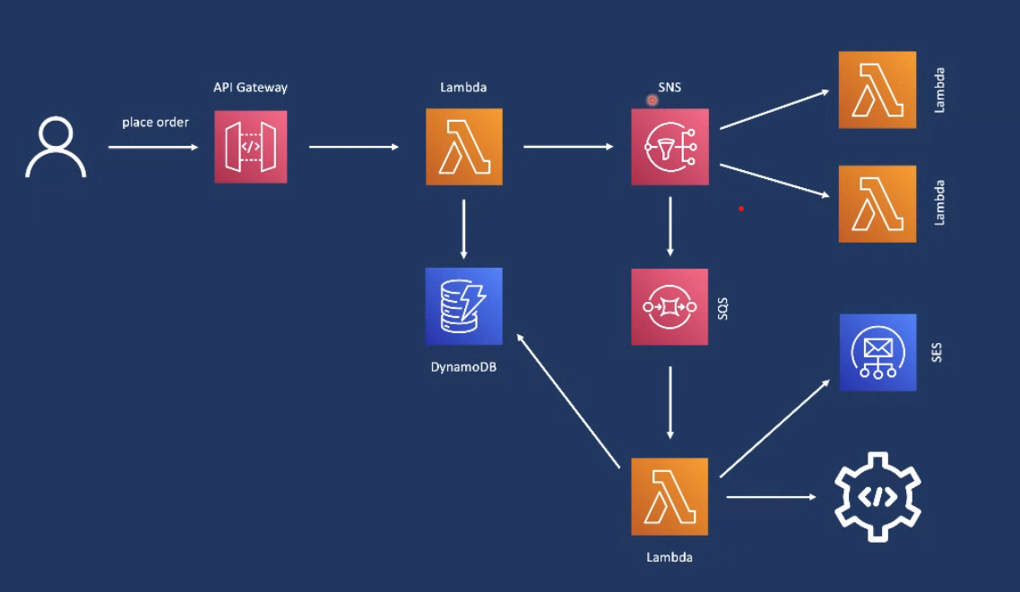
Notes:
So is AWS (thank you Luc for show casing AWS earlier)

Slide 6
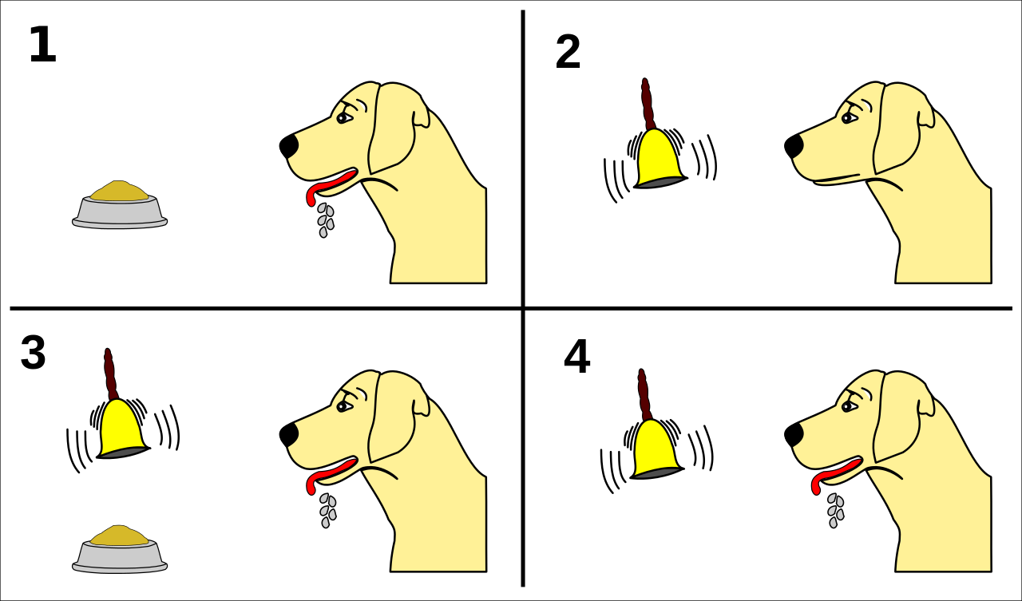
Notes:
Something happens, it triggers the funciton that needs to run, and optionally, emits some output.
Note: AWS Lambda is an equivalent of Functions (and started earlier) but I’ll focus on Functions for simplicity.

Slide 7

NServiceBus
Notes:
Glad that you asked.
It supports a variety of messaging patterns and workflows on multiple transports, including Azure Service Bus and Storage Queues for Azure, and Amazon SQS for AWS, allowing developers focus on core logic, fully abstracted from the underlying infrastructure.

Slide 8

But seriously, why NServiceBus?
Notes:
Good question to ask. What’s the value NServiceBus brings to the table when working with Functions. And how does it help anything, let along elevates.

Slide 9

Notes:
Because the world is not “one size fits all”.
I’ll focus on a few things during this session but remember – everything we’ll see is applicable not just to Functions.

Slide 10
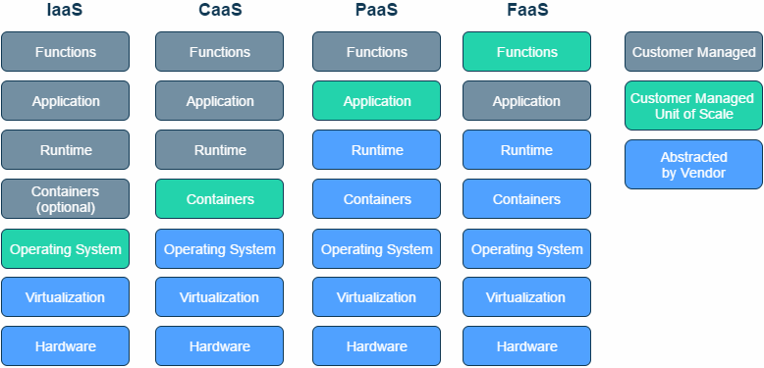
Notes:
VMs, Containers, WebApps or Functions, you name it!

Slide 11
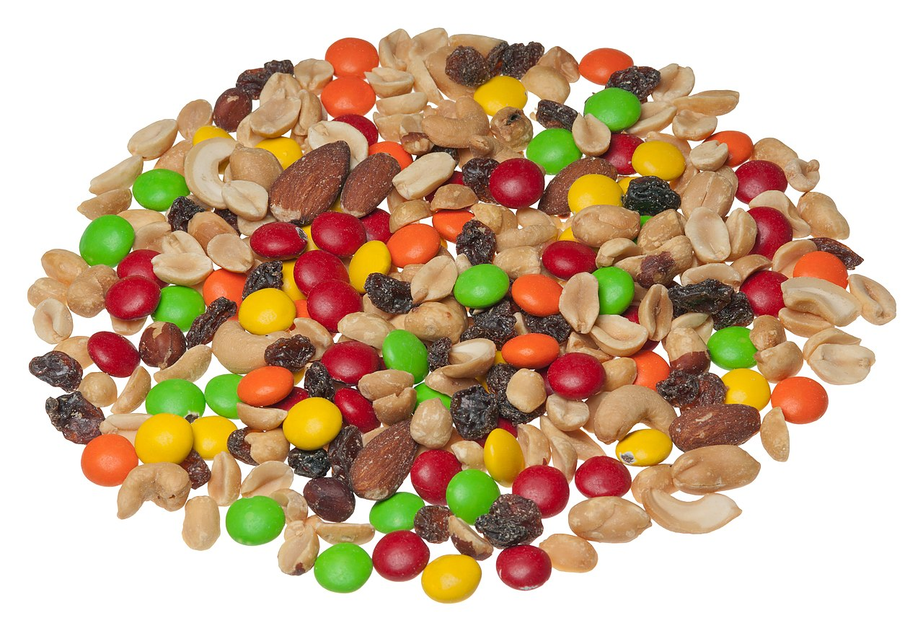
Notes:
Wherever your system is solely one of the flavours or mix, NServiceBus lands itself anywhere, allowing focusing on that business development w/o spending time on the mundane infrastructure concerns. Including Functions. About that, time to focus on Functions.

Slide 12


Messaging function anatomy
Trigger
Function
Output
Notes:
Let’s take a simple Azure Functions that deals with an incoming message, does some work and publishes a notification event.

Slide 13
[FunctionName("MyFunction")]
public async Task Run(
[ServiceBusTrigger(queueName: "myqueue")] string message,
[ServiceBus("mytopic", EntityType = EntityType.Topic)] IAsyncCollector<string> collector
ILogger logger, ExecutionContext executionContext)
{
// Process the message
}
Notes:
Simple right? I should say “simple to write”. But not to grow and maintain.
Let’s look at just a few challenges associated with this function.
---------- LATER SLIDES ----------
The message is coming as a string. Need to deserialize it.
To emit a message, I can use a “return” attribute if it’s a single message, or a collector/async collector if it’s an async method or multiple messages.
ICollector sends messages immediately. IAsyncCollector batches messages and flushes when the function completes.
And if the processing fails? Thanks goodness there’s error handling and retries. But retries are either fixed or exponential (FixedDelayRetry/ExponentialBackoffRetry) and there’s no way to define “unrecoverable exceptions” where retries are not necessary.
Messages failing all retries are dead-lettered to a DLQ per input queue – need to monitor all of those DLQs. And there can be plenty.
Why plenty? Because for each message type there’s usually a different function defined to keep logic separate. And that’s where it starts to bleed. Badly.

Slide 14
[FunctionName("MyFunction")]
public async Task Run(
[ServiceBusTrigger(queueName: "myqueue")] string message,
[ServiceBus("mytopic", EntityType = EntityType.Topic)] IAsyncCollector<string> collector
ILogger logger, ExecutionContext executionContext)
{
// Process the message
}
Notes:
1. The message is coming as a string. Need to deserialize it.
And while it’s possible to turn it into a POCO

Slide 15
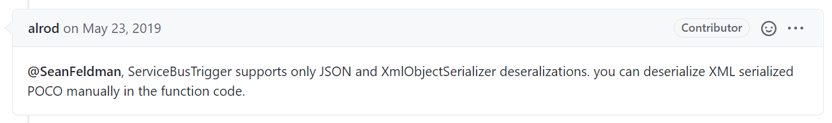
[FunctionName("MyFunction")]
public async Task Run(
[ServiceBusTrigger(queueName: "myqueue")] Poco message,
[ServiceBus("mytopic", EntityType = EntityType.Topic)] IAsyncCollector<string> collector
ILogger logger, ExecutionContext executionContext)
{
// Process the message
}
Notes:
2. The message is coming as a string. Need to deserialize it.
And while it’s possible to turn it into a POCO, it will only work when the payload is serialized as JSON.

Slide 16
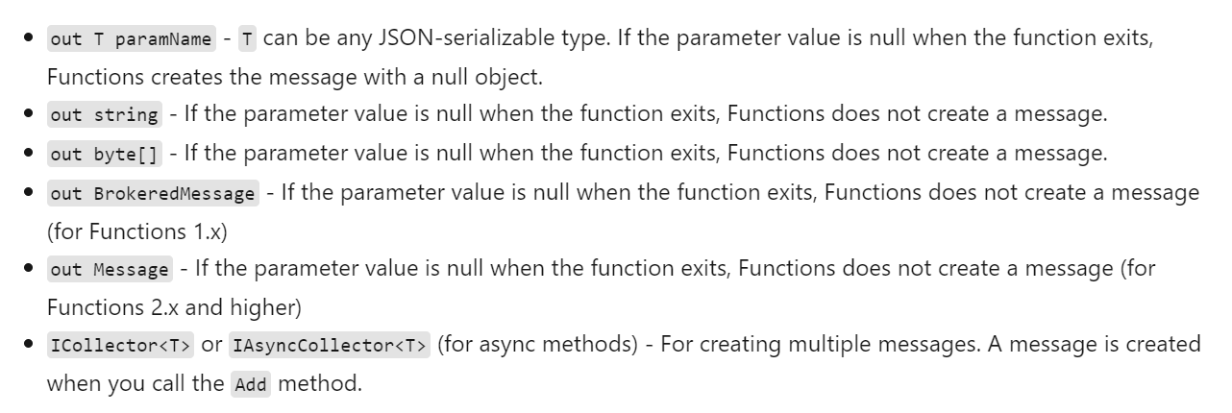
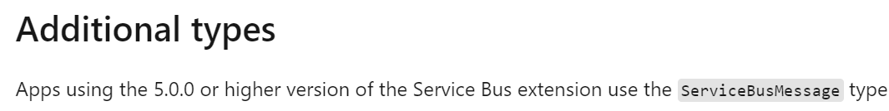
[FunctionName("MyFunction")]
public async Task Run(
[ServiceBusTrigger(queueName: "myqueue")] string message,
[ServiceBus("mytopic", EntityType = EntityType.Topic)] IAsyncCollector<string> collector
ILogger logger, ExecutionContext executionContext)
{
// Process the message
}
Notes:
2. To emit a message, I can need to differentiate between
Synchronous and asynchronous method
Single message vs multiple message
SDK type

Slide 17
[FunctionName("MyFunction")]
public async Task Run(
[ServiceBusTrigger(queueName: "myqueue")] string message,
[ServiceBus("mytopic", EntityType = EntityType.Topic)] IAsyncCollector<string> collector
ILogger logger, ExecutionContext executionContext)
{
// Process the message
}
Notes:
3. ICollector sends messages immediately. IAsyncCollector batches messages and flushes when the function completes.

Slide 18



[FixedDelayRetry(5, "00:00:10")] // [ExponentialBackoffRetry(5, "00:00:10")]
[FunctionName("MyFunction")]
public async Task Run(
[ServiceBusTrigger(queueName: "myqueue")] string message,
[ServiceBus("mytopic", EntityType = EntityType.Topic)] IAsyncCollector<string> collector
ILogger logger, ExecutionContext executionContext)
{
// Process the message
}
Notes:
4. And if the processing fails?
Thanks goodness there’s error handling and retries. Retries are either fixed or exponential (FixedDelayRetry/ExponentialBackoffRetry) BUT
- A misalignement between number of retries on Functions and number of delivery attempts for Service bus will result in messages ending up in dead-letter queue
- Also, there’s no way to define “unrecoverable exceptions” where retries are not necessary.

Slide 19
[FunctionName("MyFunction")]
public async Task Run(
[ServiceBusTrigger(queueName: "myqueue")] string message,
[ServiceBus("mytopic", EntityType = EntityType.Topic)] IAsyncCollector<string> collector
ILogger logger, ExecutionContext executionContext)
{
// Process the message
}
Notes:
5. Messages failing all retries are dead-lettered to a DLQ per input queue – need to monitor all of those DLQs. And there can be plenty.

Slide 20

[FunctionName("Function1")]
public async Task Run([ServiceBusTrigger(queueName: "myqueue1")] string message)
{
}
[FunctionName("Function2")]
public async Task Run([ServiceBusTrigger(queueName: "myqueue2")] string message)
{
}
[FunctionName("FunctionN")]
public async Task Run([ServiceBusTrigger(queueName: "myqueue3")] string message)
{
}
Notes:
Why plenty?
And here we’re arriving at one of the big design constrants
6. Because for each message type there’s usually a different function defined to keep logic separate. And that’s where it starts to bleed. Badly.

Slide 21

I did not sign up for this
Notes:
And if you fast forward the project into the future, it ain’t looking great.

Slide 22

Notes:
Functions were supposed to make it simpler to focus on what matters.
So let’s focus on what matters – the core logic.

Slide 23
Messaging function anatomy with NServiceBus
Trigger
NServiceBus
Output
Notes:
NServiceBus leverages the trigger part of Azure Functions replacing the processing and the output aspects.

Slide 24
class MyRequestHandler : IHandleMessages<MyRequestClass>
{
Task Handle(MyRequestClass message, IMessageHandlerContext context)
{
// Process the message
await context.Publish(new SomethingHappened { Id = message.Id });
}
}
Notes:
MyRequestMessage is a POCO class that represents a command or an event that took place and has triggered the function.
IHandleMessages is wiring this class, MyRequestHandler to receive the message of the type MyRequestClass.
Handle method will be invoked automatically, passing the message as a POCO for us to handle.
Context is an object passed in by NServiceBus, similar to a context provided by Durable Functions API, to allow various operations. In the context of NSB it’s publishing events and sending commands.

Slide 25
class MyRequestHandler : IHandleMessages<MyRequestClass>
{
Task Handle(MyRequestClass message, IMessageHandlerContext context)
{
// Process the message
await context.Publish(new SomethingHappened { Id = message.Id });
await context.Send(new SendEmail { To = … });
}
}
Notes:
And to send a message (command) rather than publish

Slide 26


class MyRequestHandler : IHandleMessages<MyRequestClass>
{
Task Handle(MyRequestClass message, IMessageHandlerContext context)
{
await context.Publish(new SomethingHappened { Id = message.Id });
// Process the message
}
}
Notes:
The order doesn’t matter, by default NServiceBus batches the messages, allowing the handler to complete and only then dispatches the messages

Slide 27


Recoverability
Immediate retries
Unrecoverable exceptions
Delayed retries
Custom recoverability policy

Slide 28
class MyRequestHandler : IHandleMessages<MyRequestClass>
{
Task Handle(MyRequestClass message, IMessageHandlerContext context)
{
await context.Publish(new SomethingHappened { Id = message.Id });
// Process the message
}
}
Centralized
error queue
Notes:
What happens when a message fails processing after all retries?
It’s moved to the centralized error queue.
All failed messages are moved to the same centralized queue.

Slide 29
class Message1Handler : IHandleMessages<Message1>
{
Task Handle(Message1 message, IMessageHandlerContext context)
{
// Process the message
await context.Publish(new SomethingHappened { Id = message.Id });
}
}
class Message2Handler : IHandleMessages<Message2>
{
Task Handle(Message2 message, IMessageHandlerContext context)
{
// Process the message
await context.Publish(new SomethingElseHappened { Id = message.Id });
}
}
Notes:
And how are multiple message types are handled? In a very simple way

Slide 30

Notes:
Alright, Sean. That’s a nice trick but how does it work?

Slide 31
class Startup : FunctionsStartup
{
public override void Configure(IFunctionsHostBuilder builder)
{
builder.UseNServiceBus(() =>
new ServiceBusTriggeredEndpointConfiguration("FunctionsEndpoint"));
}
}
Recoverability
Serialization
Message Routing
Pipelines (advanced extensibility)
And more
Notes:
NServiceBus is registered with Azure Functions host builder using a logical endpoint name.
ServiceBusTriggeredEndpointConfiguration is the gateway into configuring NServiceBus endpoint. That includes recoverability, serialization, routing,

Slide 32
class ServiceBusFunctionHost
{
public async ServiceBusFunctionHost(IFunctionEndpoint functionEndpoint)
{
this.functionEndpoint = functionEndpoint;
}
public async Task Run([ServiceBusTrigger(queueName: "myqueue")] Message message,
ILogger logger, ExecutionContext executionContext)
{
await functionEndpoint.Process(message, logger, executionContext);
}
private IFunctionEndpoint functionEndpoint;
}
Notes:
To delegate processing from Azure Functions to NServiceBus, a single Function has to exist, a function that is triggered by Functions runtime.
It can be a message triggered or any other function. For non-message triggered function, an endpoint would be considered a send-only as it only would send messages out and not receive.
IFunctionEndpoint is the NServiceBus context.
The delegation is done by invoking the Process method, passing the incoming message, the logger, and the execution context received by the triggered function.

Slide 33

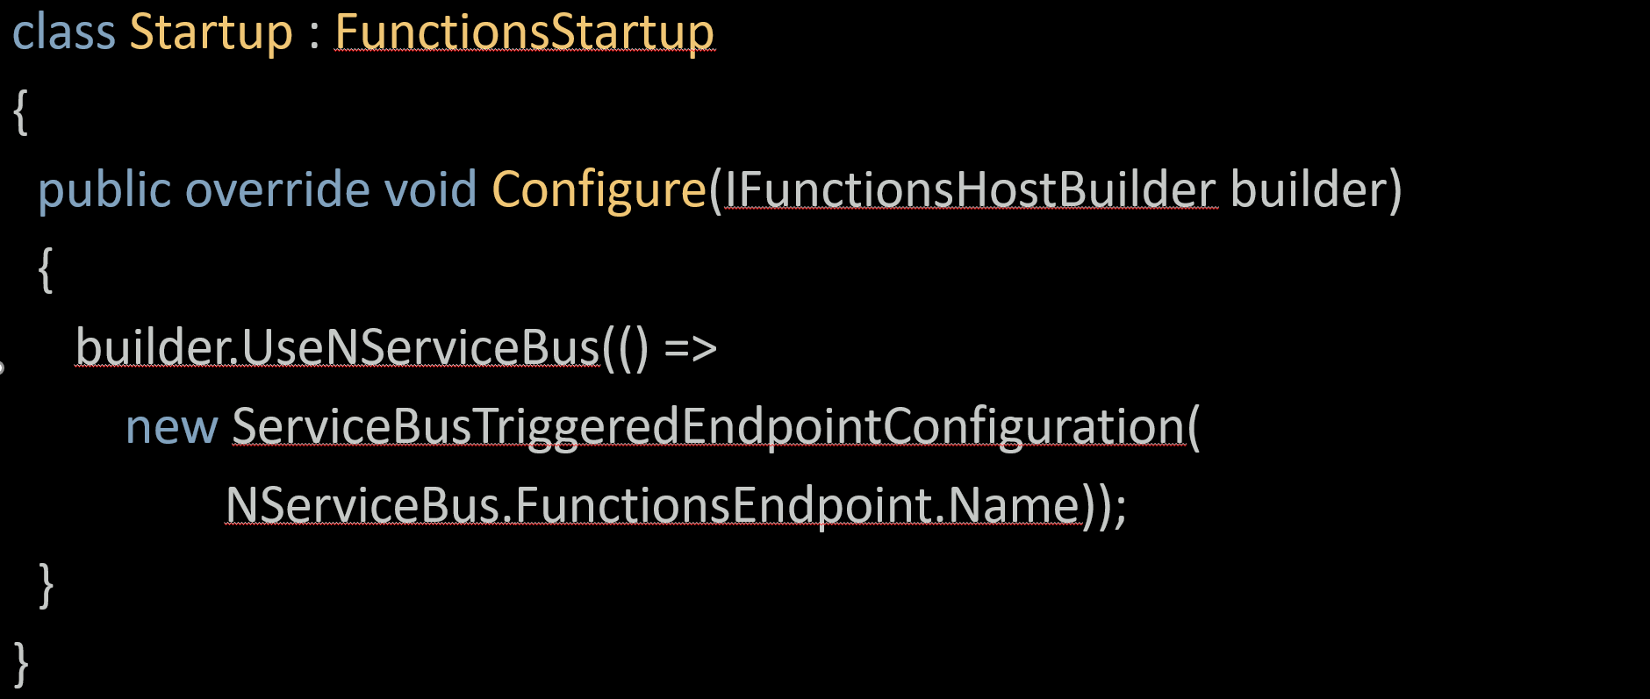
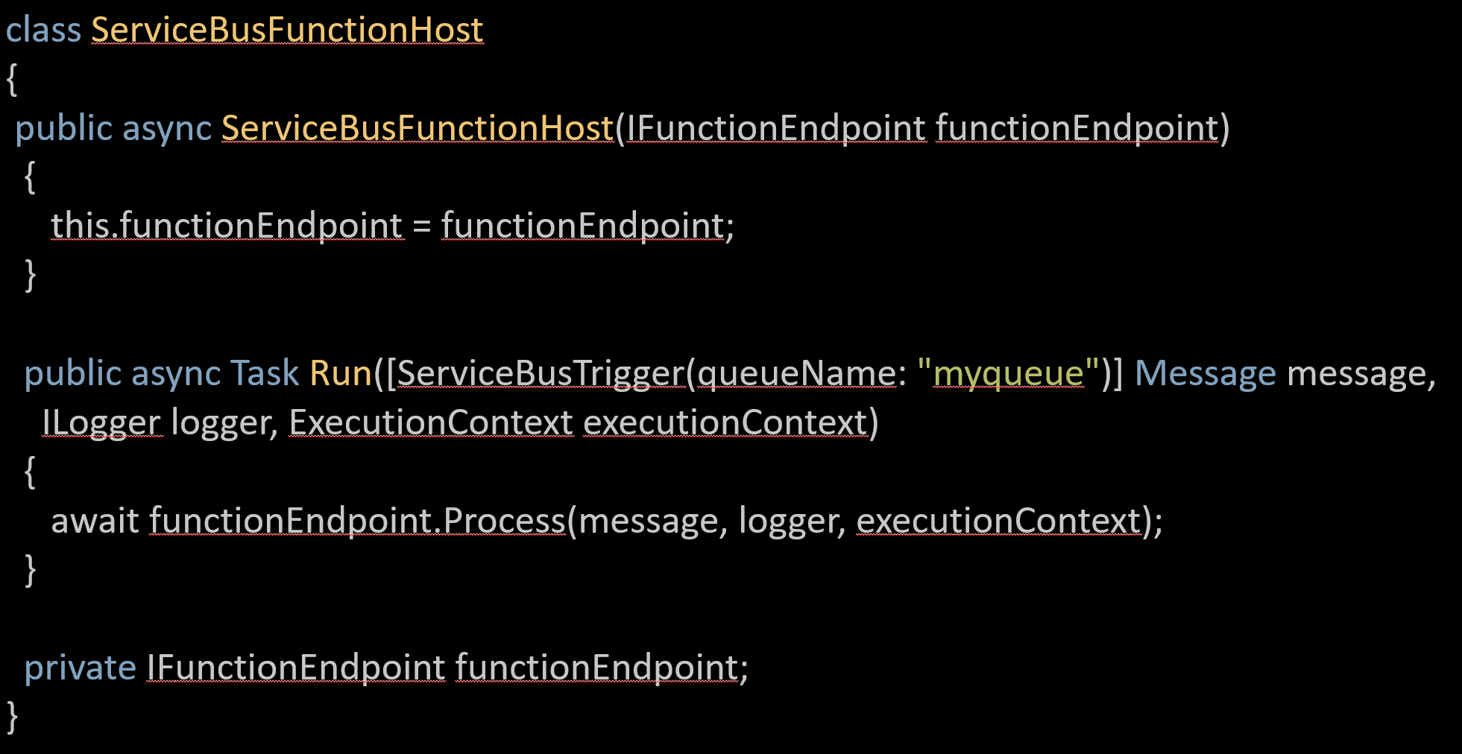
// warning: fake news
Notes:
Now if I look into the future, I can see that the host function will not be required. Thanks to C# 9 code generators, it will be possible to eliminate it altogether.

Slide 34
[NServiceBusEndpoint(Name="FunctionsEndpoint")] // warning: fake news
class Startup : FunctionsStartup
{
public override void Configure(IFunctionsHostBuilder builder)
{
builder.UseNServiceBus(() =>
new ServiceBusTriggeredEndpointConfiguration(
NServiceBus.FunctionsEndpoint.Name));
}
}
Notes:
NServiceBus is registered with Azure Functions host builder using a logical endpoint name.
ServiceBusTriggeredEndpointConfiguration is the gateway into configuring NServiceBus endpoint. That includes recoverability, serialization, routing,

Slide 35

Example: Ping Pong
Notes:
This is a full duplex example. NServiceBus supports a concept called conversation, where a message can be associated with the originating message w/o the need to keep the information around.
In this case, we’ll have one end point sending the ping command to the well known destination and the receiver of the ping message will reply with the pong command, w/o knowing who was the originator.
To make it a bit more interesting, we’ll first create the two endpoints as console application and then map those to Azure Functions.

Slide 36

Example: User registration flow
Notes:
In this example we’ll look at a feature called Saga. Saga feature is a coordinator pattern. An equivalent with Azure Functions is called Durable Functions. Except Saga is much more refined as well as a simpler to code. Let’s have a look.

Slide 37


Registration workflow
email
Register the intent
Confirmation link
password
Register
24 hours
Confirmation link
Send a reminder
48 hours
Terminate registration

Slide 38

May 2021: NServiceBus.AzureFunctions.InProcess.ServiceBus 1.0
Next: Isolated Worker SDK support (separate package)

Slide 39

THANK YOU
@sfeldman
feldman.sean@gmail.com
weblogs.asp.net/sfeldman

